Slide 1
HEALTH CARE MANAGEMENT PREDICTION
CHARLES OFOSU APPIAH

Slide 2
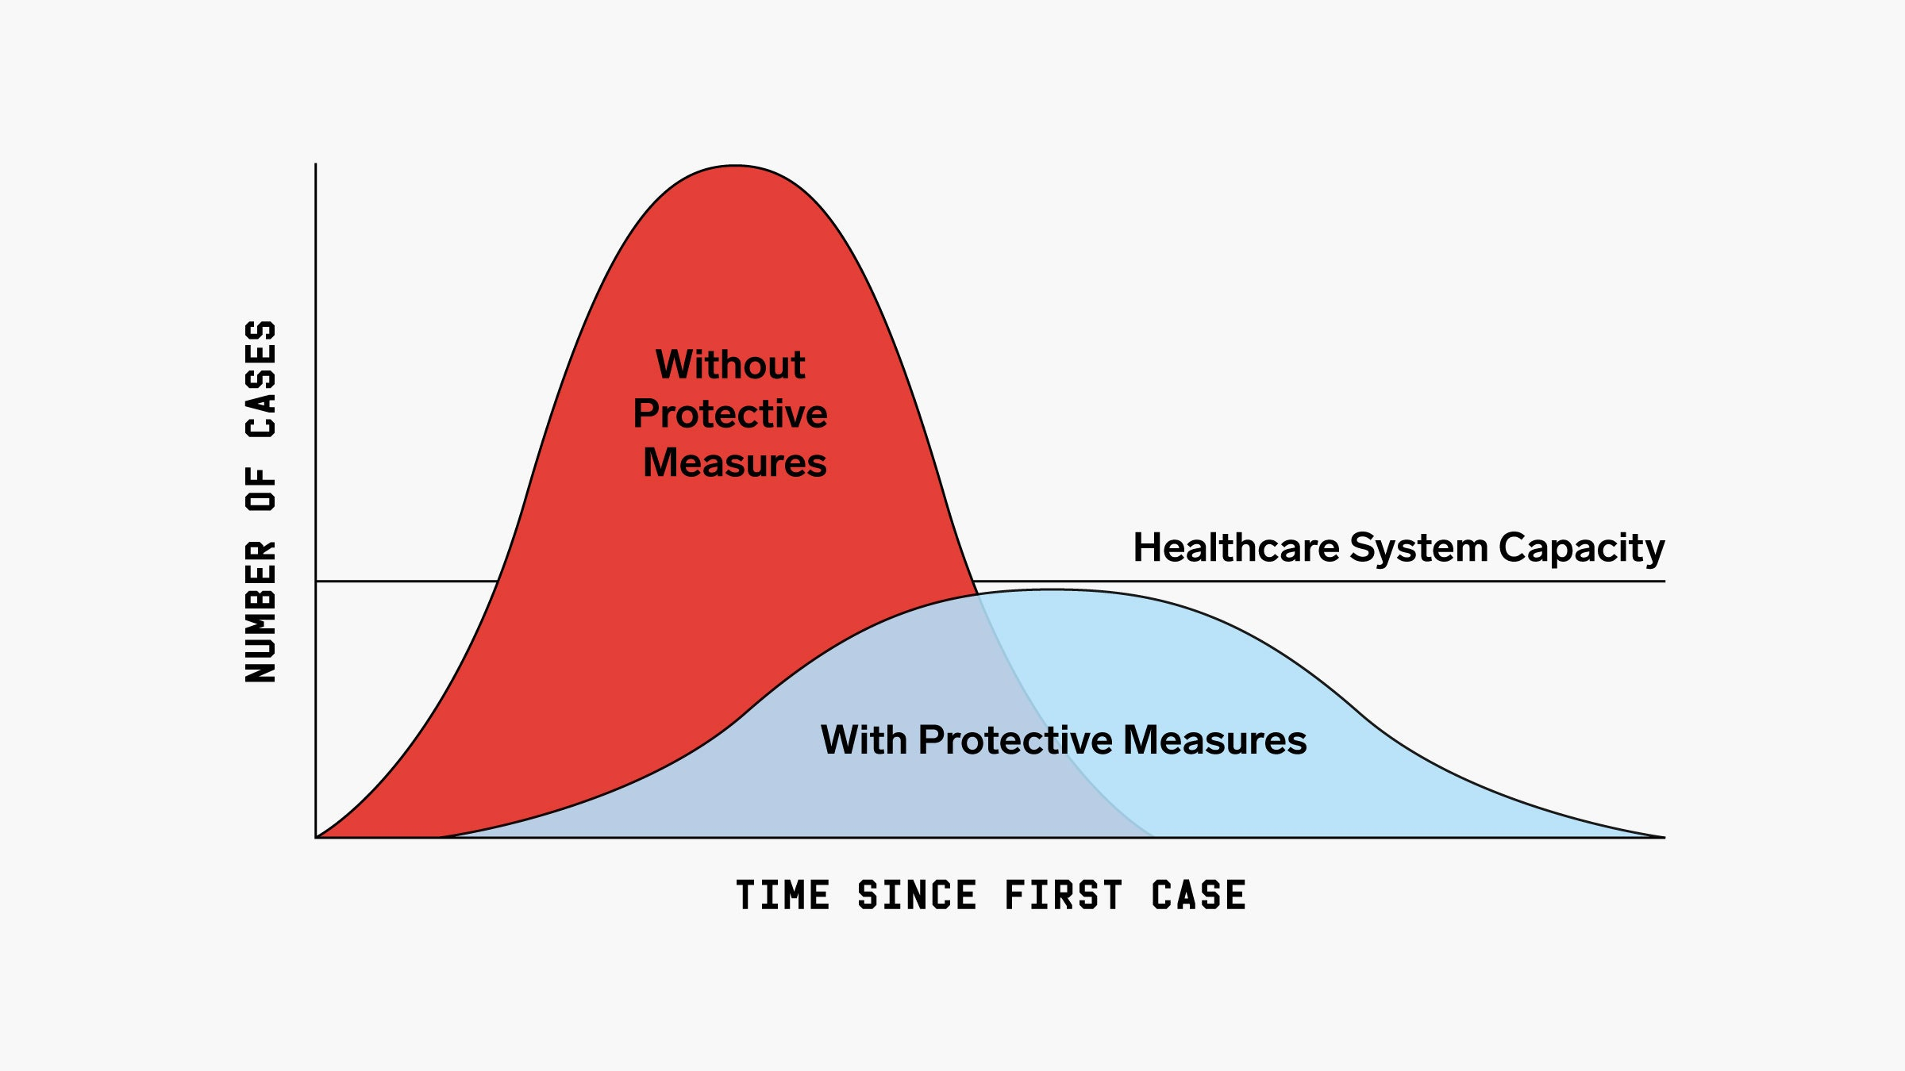

Slide 3
Data
Objectives
Determine if the length of stay is influence by
Hospital type
Age of the patient
Type of admission
Severity of the admission
Number of visitors etc
Build an algorithm will predict the length of stay for incoming patient

Slide 4
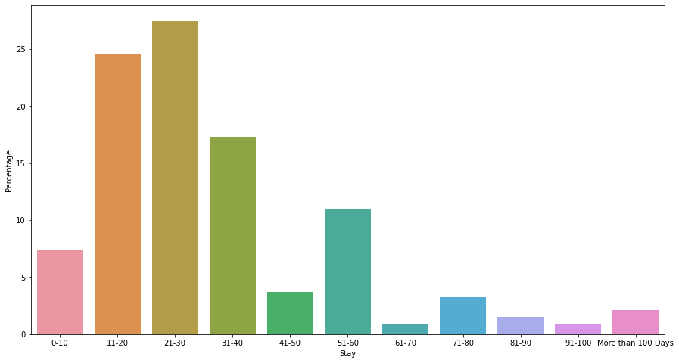
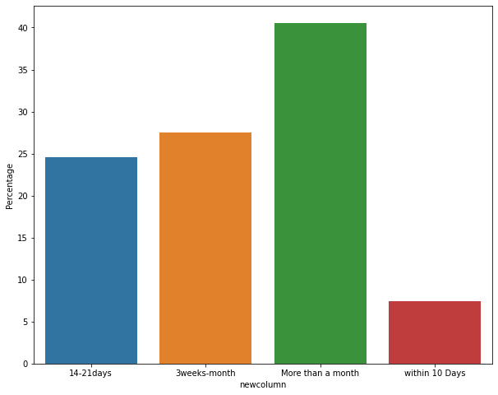

Slide 5
 | precision | recall | f1-score | support
More than a month | 0.45 | 0.79 | 0.57 | 25793
3 weeks-month | 0.37 | 0.30 | 0.33 | 17480
Less than 3 weeks | 0.30 | 0.09 | 0.14 | 15654
1 – 10 days | 0.00 | 0.00 | 0.00 | 4761
Accuracy Score: 0.42339216178872

Slide 6
conclusion
Next step
Optimization of the model to make it efficient
Troubleshoot areas the affect the length of stay

Slide 7

Email: cofosu.appiaha@gmail.com
Linkedin: linkedin.com/in/charles-ofosu-appiah
Github: https://github.com/Ofosu-Appiah

